Slide 1

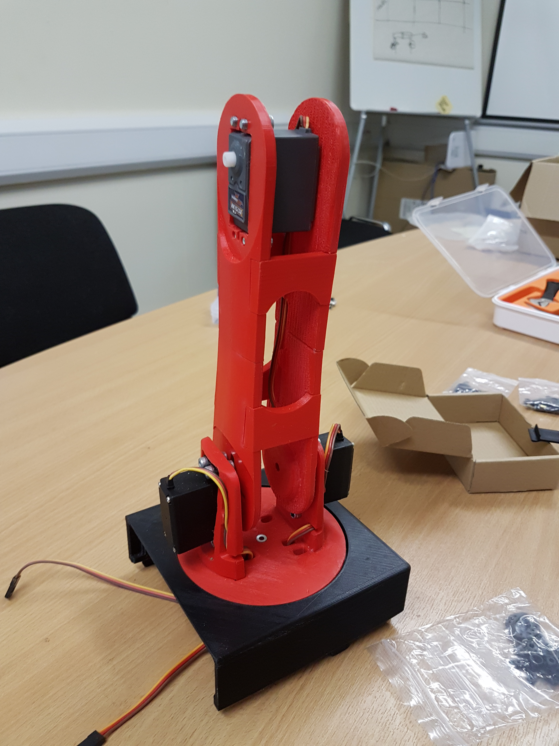
Robotic Arm
By Liam , Darragh, Aaron, Cian and Daire

Slide 2
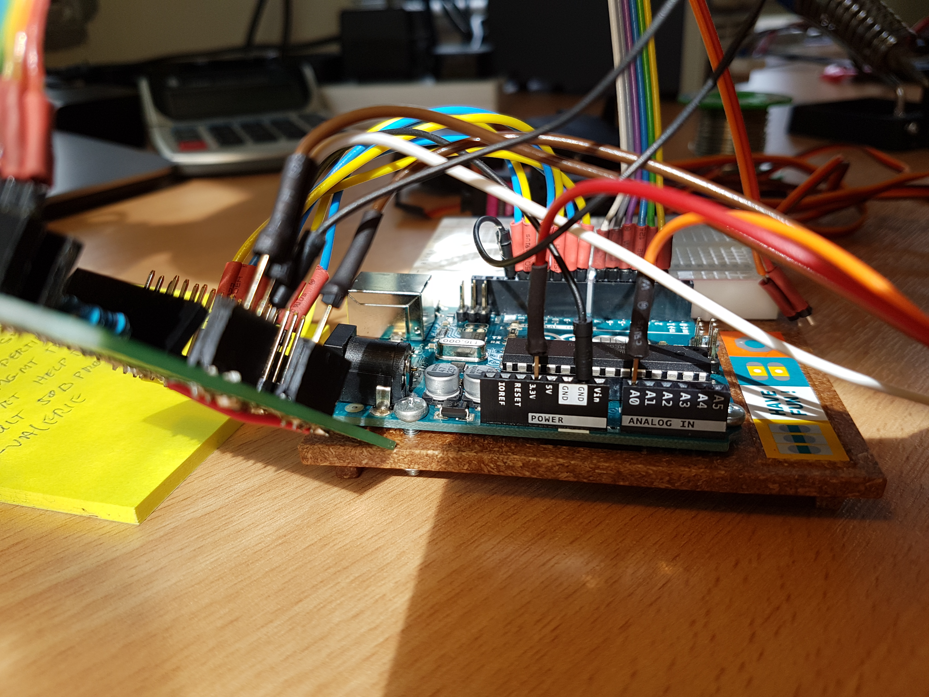
About us
We are from Carrick-on-shannon Coderdojo and we thoroughly
enjoy our time at Coderdojo

Slide 3
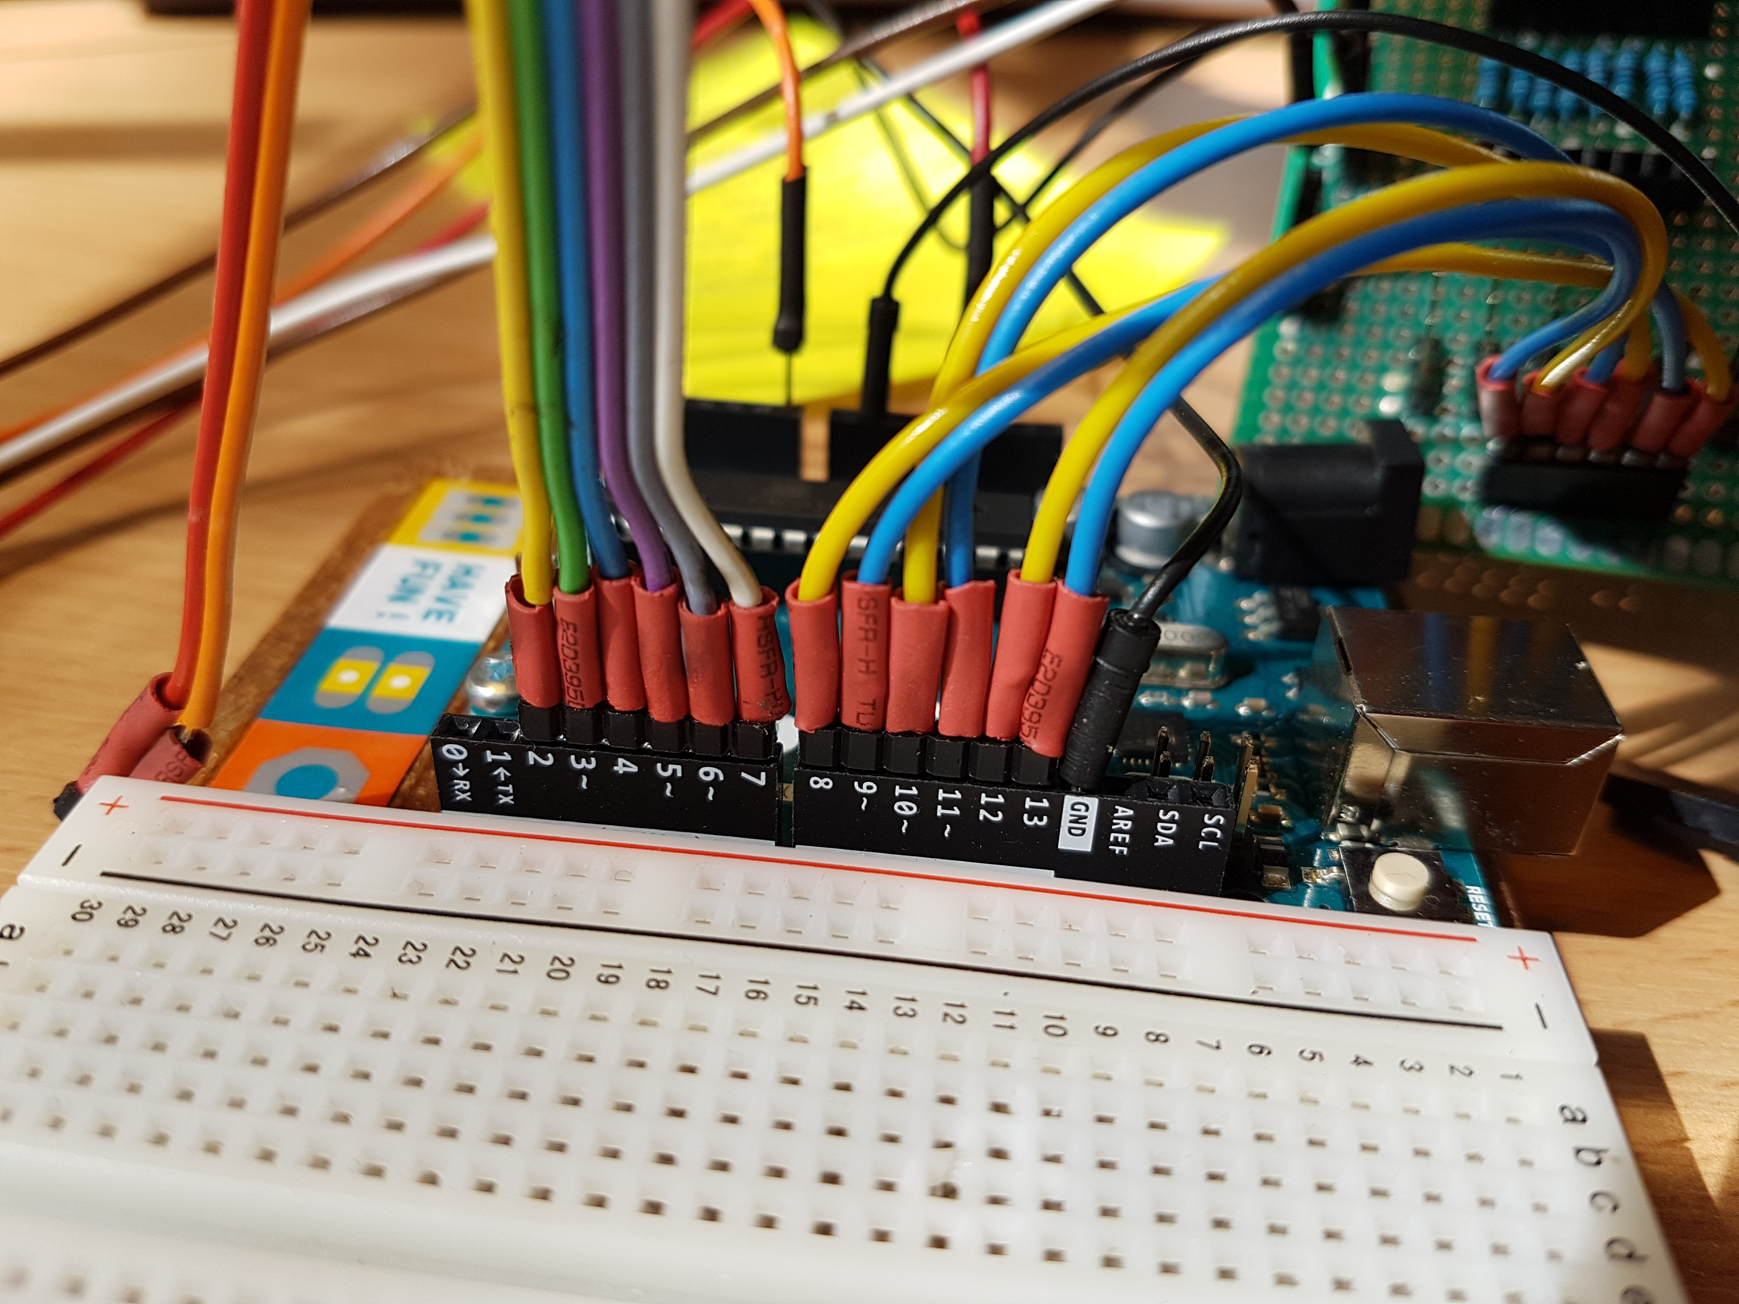
Why we made this
We made this project because we were interested in servos and how they worked, so why no make a robot arm!

Slide 4
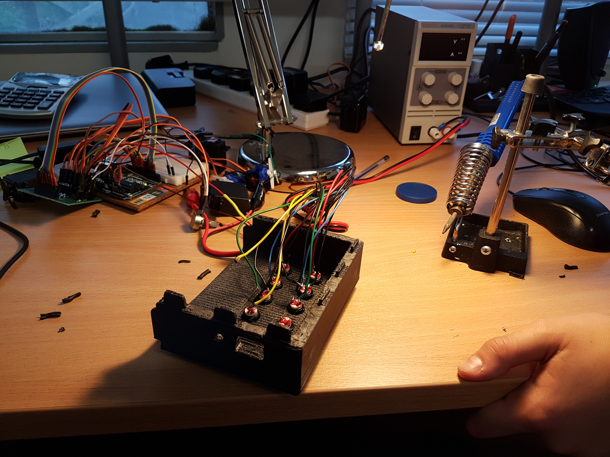
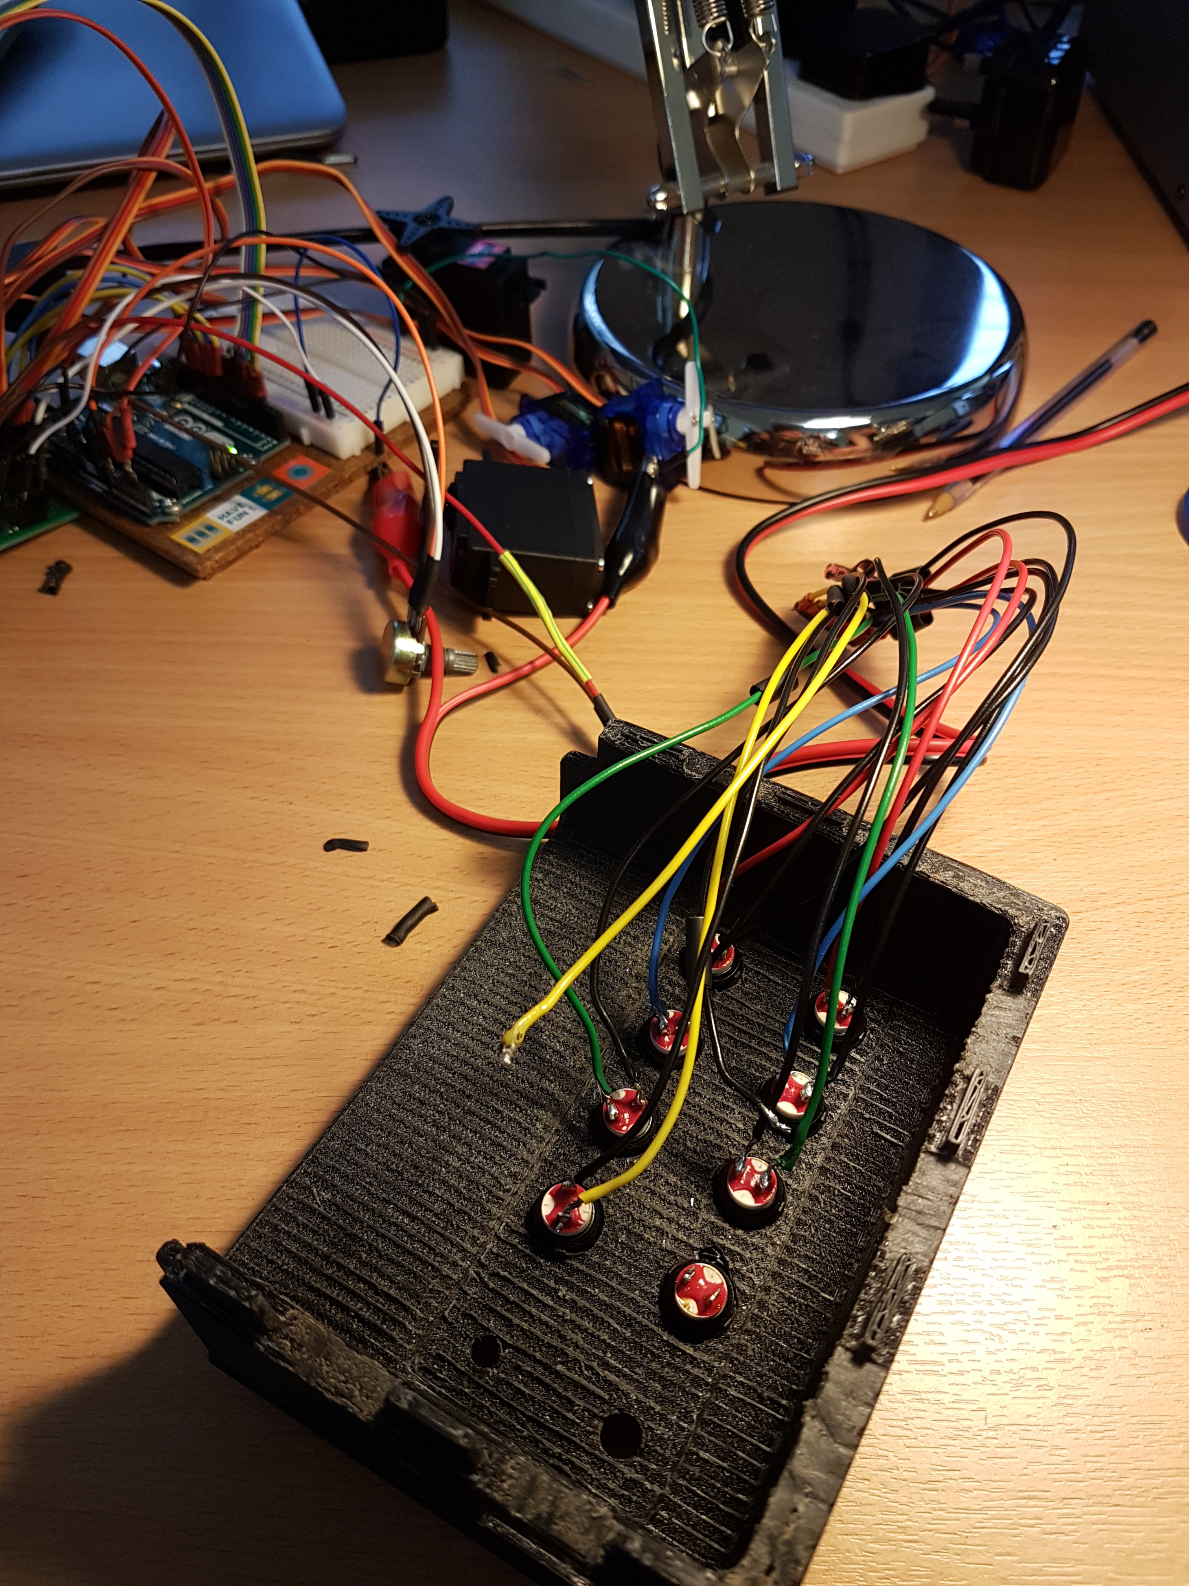
Pictures

